Slide 1
The Nervous System

Slide 2
Cerebellum
Two hemispheres with convoluted surfaces
Provides involuntary coordination of body movements

Slide 3
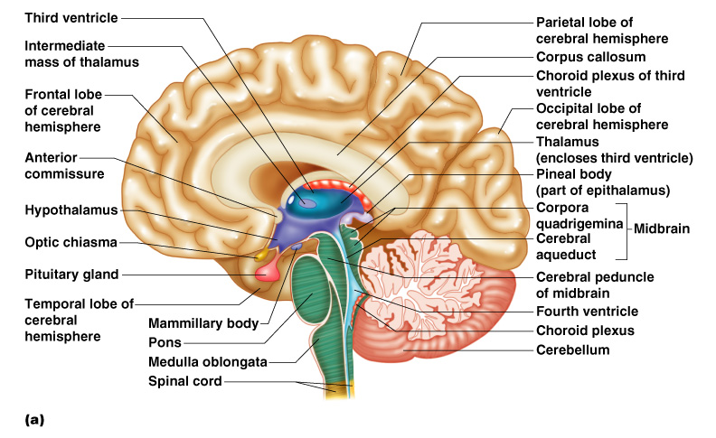
Cerebellum
Figure 7.15a

Slide 4
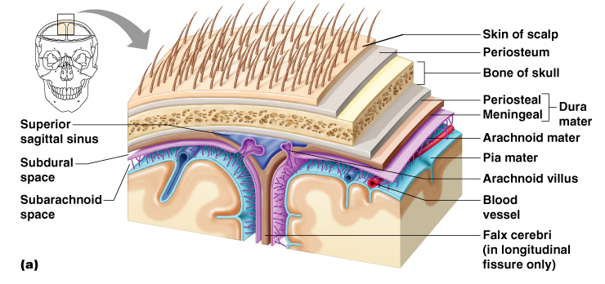
Protection of the Central Nervous System
Scalp and skin
Skull and vertebral column
Meninges
Figure 7.16a

Slide 5
Protection of the Central Nervous System
Cerebrospinal fluid
Blood brain barrier
Figure 7.16a

Slide 6
Meninges
Dura mater
  Double-layered external covering
    Periosteum – attached to surface of the skull
    Meningeal layer – outer covering of the brain
  Folds inward in several areas

Slide 7
Meninges
Arachnoid layer
  Middle layer
  Web-like
Pia mater
  Internal layer
  Clings to the surface of the brain

Slide 8
Cerebrospinal Fluid
Similar to blood plasma composition
Formed by the choroid plexus
Forms a watery cushion to protect the brain
Circulated in arachnoid space, ventricles, and central canal of the spinal cord

Slide 9
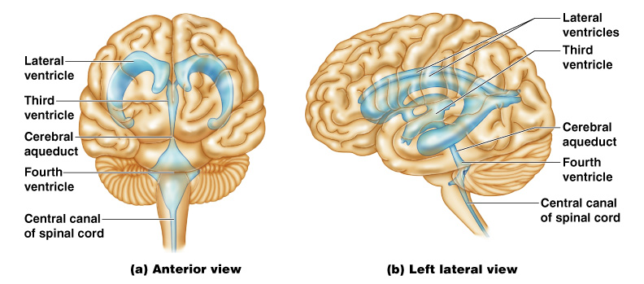
Ventricles and Location of the Cerebrospinal Fluid
Figure 7.17a–b

Slide 10
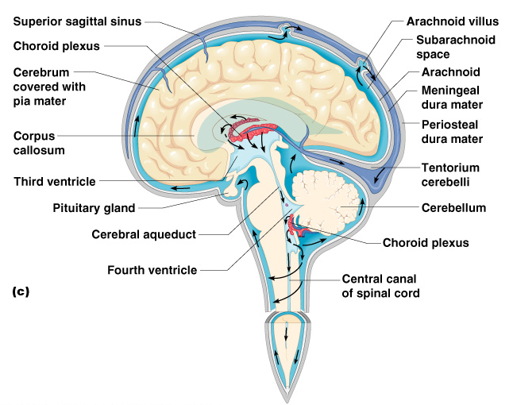
Ventricles and Location of the Cerebrospinal Fluid
Figure 7.17c

Slide 11
Blood Brain Barrier
Includes the least permeable capillaries of the body
Excludes many potentially harmful substances
Useless against some substances
  Fats and fat soluble molecules
  Respiratory gases
  Alcohol
  Nicotine
  Anesthesia

Slide 12
Traumatic Brain Injuries
Concussion
  Slight brain injury
  No permanent brain damage
Contusion
  Nervous tissue destruction occurs
  Nervous tissue does not regenerate
Cerebral edema
  Swelling from the inflammatory response
  May compress and kill brain tissue

Slide 13
Cerebrovascular Accident (CVA)
Commonly called a stroke
The result of a ruptured blood vessel supplying a region of the brain
Brain tissue supplied with oxygen from that blood source dies
Loss of some functions or death may result

Slide 14
Alzheimer’s Disease
Progressive degenerative brain disease
Mostly seen in the elderly, but may begin in middle age
Structural changes in the brain include abnormal protein deposits and twisted fibers within neurons
Victims experience memory loss, irritability, confusion and ultimately, hallucinations and death

Slide 15
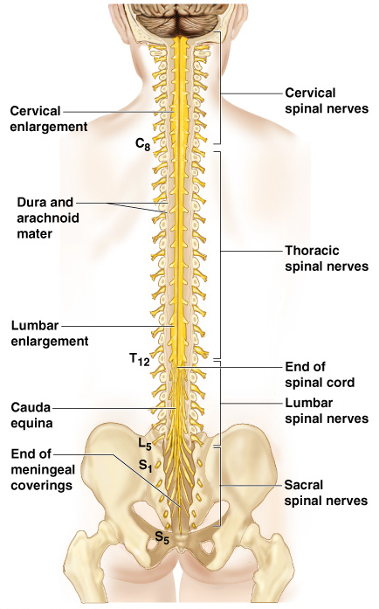
Spinal Cord
Extends from the medulla oblongata to the region of T12
Below T12 is the cauda equina (a collection of spinal nerves)
Enlargements occur in the cervical and lumbar regions
Figure 7.18

Slide 16
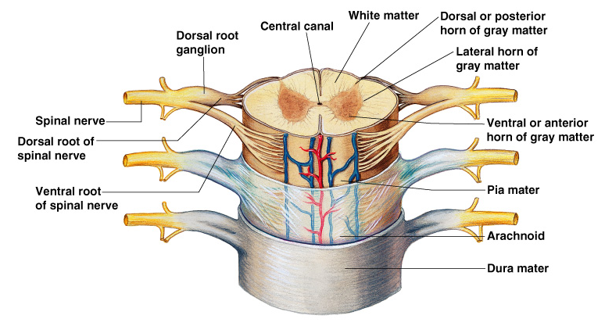
Spinal Cord Anatomy
Exterior white mater – conduction tracts
Figure 7.19

Slide 17
Spinal Cord Anatomy
Internal gray matter - mostly cell bodies
  Dorsal (posterior) horns
  Anterior (ventral) horns
Figure 7.19

Slide 18
Spinal Cord Anatomy
Central canal filled with cerebrospinal fluid
Figure 7.19

Slide 19
Spinal Cord Anatomy
Meninges cover the spinal cord
Nerves leave at the level of each vertebrae
  Dorsal root
    Associated with the dorsal root ganglia – collections of cell bodies outside the central nervous system
  Ventral root

Slide 20
Peripheral Nervous System
Nerves and ganglia outside the central nervous system
Nerve = bundle of neuron fibers
Neuron fibers are bundled by connective tissue

Slide 21
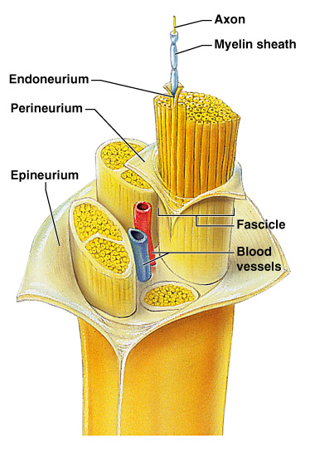
Structure of a Nerve
Endoneurium surrounds each fiber
Groups of fibers are bound into fascicles by perineurium
Fascicles are bound together by epineurium
Figure 7.20

Slide 22
Classification of Nerves
Mixed nerves – both sensory and motor fibers
Afferent (sensory) nerves – carry impulses toward the CNS
Efferent (motor) nerves – carry impulses away from the CNS

Slide 23
Cranial Nerves
12 pairs of nerves that mostly serve the head and neck
Numbered in order, front to back
Most are mixed nerves, but three are sensory only

Slide 24
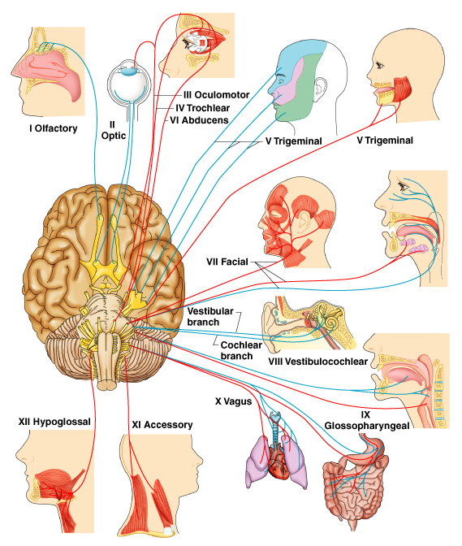
Distribution of Cranial Nerves
Figure 7.21

Slide 25
Cranial Nerves
I Olfactory nerve – sensory for smell
II Optic nerve – sensory for vision
III Oculomotor nerve – motor fibers to eye muscles
IV Trochlear – motor fiber to eye muscles

Slide 26
Cranial Nerves
V Trigeminal nerve – sensory for the face; motor fibers to chewing muscles
VI Abducens nerve –
motor fibers to eye muscles
VII Facial nerve – sensory for taste; motor fibers to the face
VIII Vestibulocochlear nerve –
sensory for balance and hearing

Slide 27
Cranial Nerves
IX Glossopharyngeal nerve – sensory for taste; motor fibers to the pharynx
X Vagus nerves – sensory and motor fibers for pharynx, larynx, and viscera
XI Accessory nerve – motor fibers to neck and upper back
XII Hypoglossal nerve – motor fibers to tongue

