Slide 1
The Nervous System

Slide 2
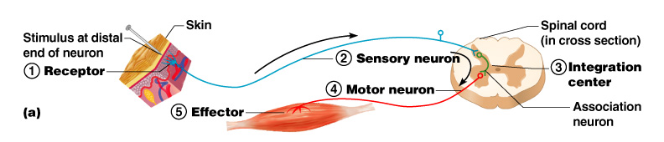
The Reflex Arc
Reflex – rapid, predictable, and involuntary responses to stimuli
Reflex arc – direct route from a sensory neuron, to an interneuron, to an effector
Figure 7.11a

Slide 3
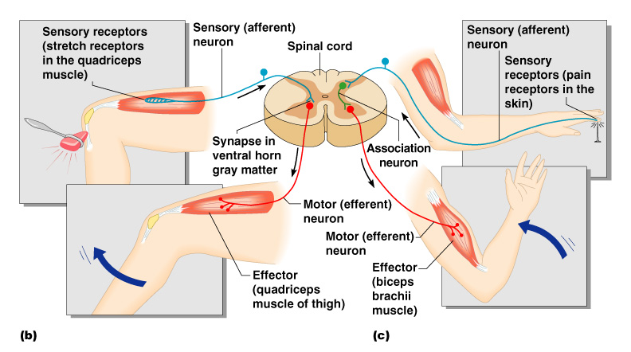
Simple Reflex Arc
Figure 7.11b–c

Slide 4
Types of Reflexes and Regulation
Autonomic reflexes
  Smooth muscle regulation
  Heart and blood pressure regulation
  Regulation of glands
  Digestive system regulation
Somatic reflexes
  Activation of skeletal muscles

Slide 5
Central Nervous System (CNS)
CNS develops from the embryonic neural tube
  The neural tube becomes the brain and spinal cord
  The opening of the neural tube becomes the ventricles
    Four chambers within the brain
    Filled with cerebrospinal fluid

Slide 6
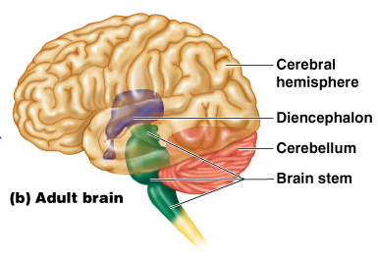
Regions of the Brain
Cerebral hemispheres
Diencephalon
Brain stem
Cerebellum
Figure 7.12b

Slide 7
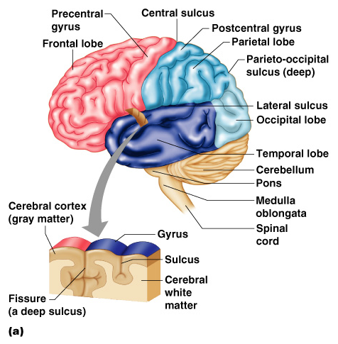
Cerebral Hemispheres (Cerebrum)
Paired (left and right) superior parts of the brain
Include more than half of the brain mass
Figure 7.13a

Slide 8
Cerebral Hemispheres (Cerebrum)
The surface is made of ridges (gyri) and grooves (sulci)
Figure 7.13a

Slide 9
Lobes of the Cerebrum
Fissures (deep grooves) divide the cerebrum into lobes
Surface lobes of the cerebrum
  Frontal lobe
  Parietal lobe
  Occipital lobe
  Temporal lobe

Slide 10
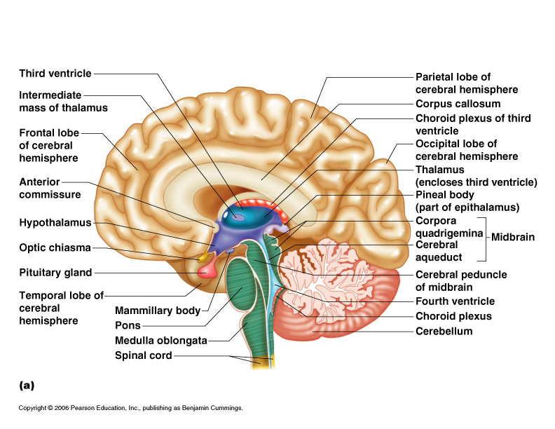
Lobes of the Cerebrum
Figure 7.15a

Slide 11
Specialized Areas of the Cerebrum
Somatic sensory area – receives impulses from the body’s sensory receptors
Primary motor area – sends impulses to skeletal muscles
Broca’s area – involved in our ability to speak

Slide 12
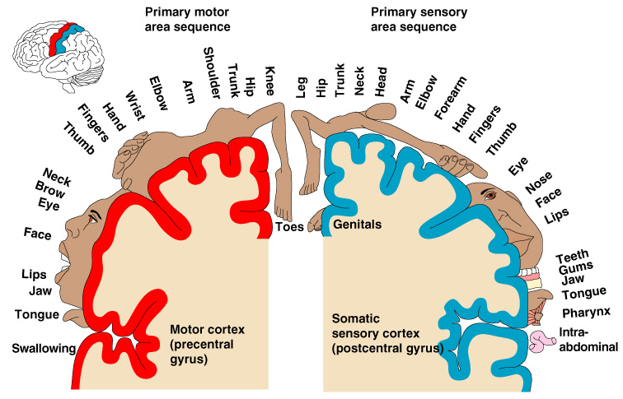
Sensory and Motor Areas of the Cerebral Cortex
Figure 7.14

Slide 13
Specialized Areas of the Cerebrum
Cerebral areas involved in special senses
  Gustatory area (taste)
  Visual area
  Auditory area
  Olfactory area

Slide 14
Specialized Areas of the Cerebrum
Interpretation areas of the cerebrum
  Speech/language region
  Language comprehension region
  General interpretation area

Slide 15
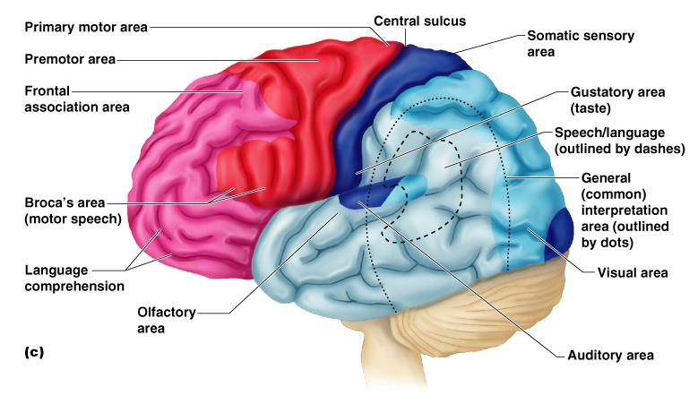
Specialized Areas of the Cerebrum
Figure 7.13c

Slide 16
Layers of the Cerebrum
Gray matter
  Outer layer
  Composed mostly of neuron cell bodies
Figure 7.13a

Slide 17
Layers of the Cerebrum
White matter
  Fiber tracts inside the gray matter
  Example: corpus callosum connects hemispheres
Figure 7.13a

Slide 18
Layers of the Cerebrum
Basal nuclei – internal islands of gray matter
Figure 7.13a

Slide 19
Diencephalon
Sits on top of the brain stem
Enclosed by the cerebral heispheres
Made of three parts
  Thalamus
  Hypothalamus
  Epithalamus

Slide 20
Diencephalon
Figure 7.15

Slide 21
Thalamus
Surrounds the third ventricle
The relay station for sensory impulses
Transfers impulses to the correct part of the cortex for localization and interpretation

Slide 22
Hypothalamus
Under the thalamus
Important autonomic nervous system center
  Helps regulate body temperature
  Controls water balance
  Regulates metabolism

Slide 23
Hypothalamus
An important part of the limbic system (emotions)
The pituitary gland is attached to the hypothalamus

Slide 24
Epithalamus
Forms the roof of the third ventricle
Houses the pineal body (an endocrine gland)
Includes the choroid plexus – forms cerebrospinal fluid

Slide 25
Brain Stem
Attaches to the spinal cord
Parts of the brain stem
  Midbrain
  Pons
  Medulla oblongata

Slide 26
Brain Stem
Figure 7.15a

Slide 27
Midbrain
Mostly composed of tracts of nerve fibers
Has two bulging fiber tracts –
cerebral peduncles
Has four rounded protrusions –
corpora quadrigemina
  Reflex centers for vision and hearing

Slide 28
Pons
The bulging center part of the brain stem
Mostly composed of fiber tracts
Includes nuclei involved in the control of breathing

Slide 29
Medulla Oblongata
The lowest part of the brain stem
Merges into the spinal cord
Includes important fiber tracts
Contains important control centers
  Heart rate control
  Blood pressure regulation
  Breathing
  Swallowing
  Vomiting

Slide 30
Reticular Formation
Diffuse mass of gray matter along the brain stem
Involved in motor control of visceral organs
Reticular activating system plays a role in awake/sleep cycles and consciousness

Slide 31
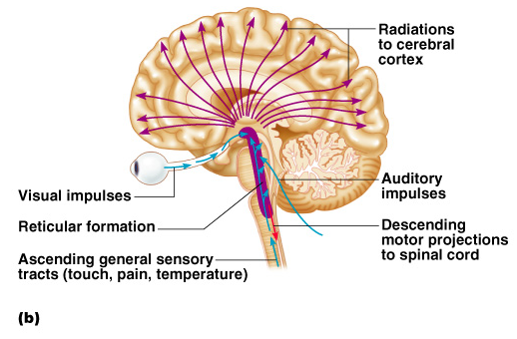
Reticular Formation
Figure 7.15b

