Slide 1
The Nervous System

Slide 2
Functions of the Nervous System
Sensory input – gathering information
  To monitor changes occurring inside and outside the body
  Changes = stimuli
Integration
  To process and interpret sensory input and decide if action is needed

Slide 3
Functions of the Nervous System
Motor output
  A response to integrated stimuli
  The response activates muscles or glands

Slide 4
Structural Classification of the Nervous System
Central nervous system (CNS)
  Brain
  Spinal cord
Peripheral nervous system (PNS)
  Nerve outside the brain and spinal cord

Slide 5
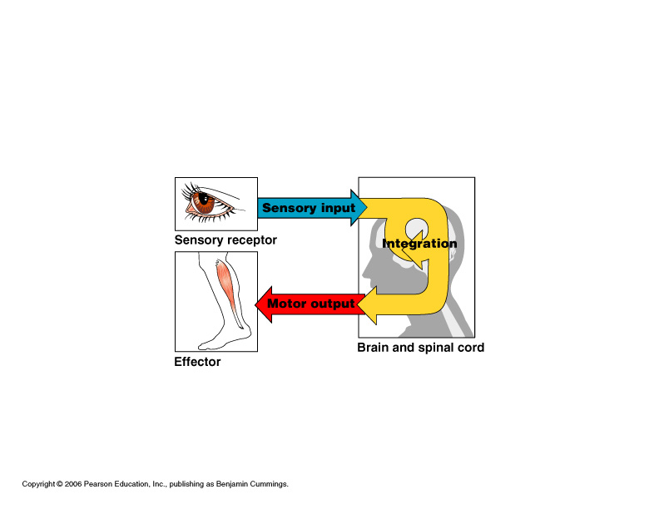
Functional Classification of the Peripheral Nervous System
Sensory (afferent) division
  Nerve fibers that carry information to the central nervous system
Figure 7.1

Slide 6
Functional Classification of the Peripheral Nervous System
Motor (efferent) division
  Nerve fibers that carry impulses away from the central nervous system
Figure 7.1

Slide 7
Functional Classification of the Peripheral Nervous System
Motor (efferent) division
  Two subdivisions
    Somatic nervous system = voluntary
    Autonomic nervous system = involuntary
Figure 7.1

Slide 8
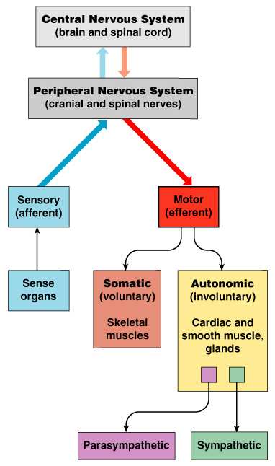
Organization of the Nervous System
Figure 7.2

Slide 9
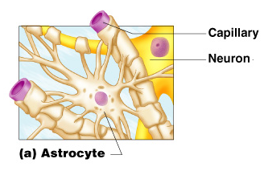
Nervous Tissue: Support Cells (Neuroglia)
Astrocytes
  Abundant, star-shaped cells
  Brace neurons
  Form barrier
  between capillaries
  and neurons
  Control the chemical
  environment of
  the brain
Figure 7.3a

Slide 10
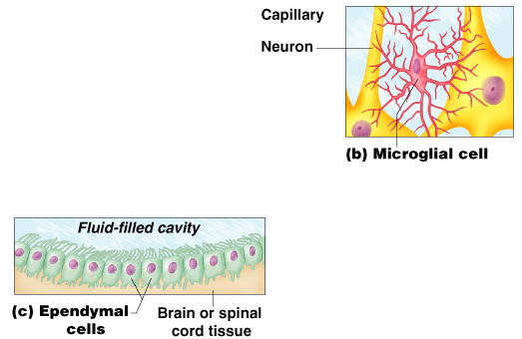
Nervous Tissue: Support Cells
Microglia
  Spider-like phagocytes
  Dispose of debris
Ependymal cells
  Line cavities of the
  brain and spinal cord
  Circulate
  cerebrospinal
  fluid
Figure 7.3b–c

Slide 11
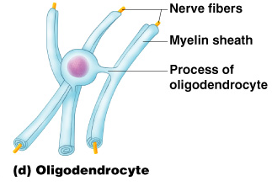
Nervous Tissue: Support Cells
Oligodendrocytes
  Produce myelin sheath around nerve fibers in the central nervous system
Figure 7.3d

Slide 12
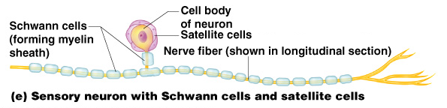
Nervous Tissue: Support Cells
Satellite cells
  Protect neuron cell bodies
Schwann cells
  Form myelin sheath in the peripheral nervous system
Figure 7.3e

Slide 13
Nervous Tissue: Neurons
Neurons = nerve cells
  Cells specialized to transmit messages
  Major regions of neurons
    Cell body – nucleus and metabolic center of the cell
    Processes – fibers that extend from the cell body

Slide 14
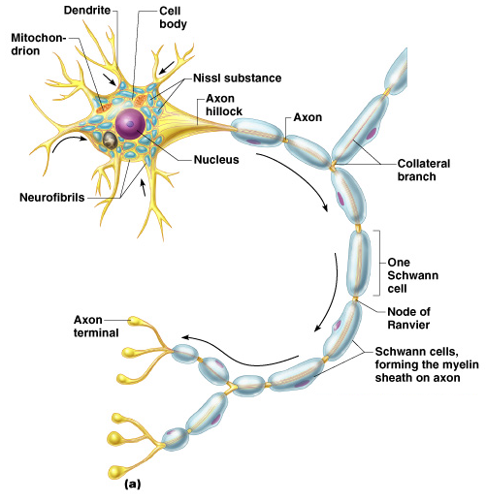
Neuron Anatomy
Cell body
  Nissl substance – specialized rough endoplasmic reticulum
  Neurofibrils – intermediate cytoskeleton that maintains cell shape
Figure 7.4a

Slide 15
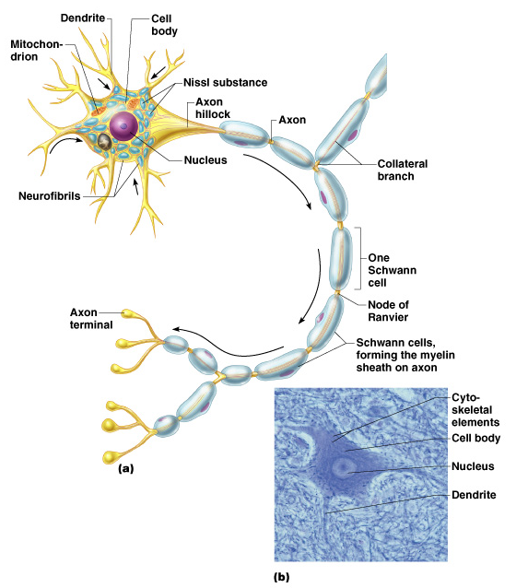
Neuron Anatomy
Cell body
  Nucleus
  Large nucleolus
Figure 7.4a–b

Slide 16
Neuron Anatomy
Extensions outside the cell body
  Dendrites – conduct impulses toward the cell body
  Axons – conduct impulses away from the cell body
Figure 7.4a

Slide 17
Axons and Nerve Impulses
Axons end in axonal terminals
Axonal terminals contain vesicles with neurotransmitters
Axonal terminals are separated from the next neuron by a gap
  Synaptic cleft – gap between adjacent neurons
  Synapse – junction between nerves

Slide 18
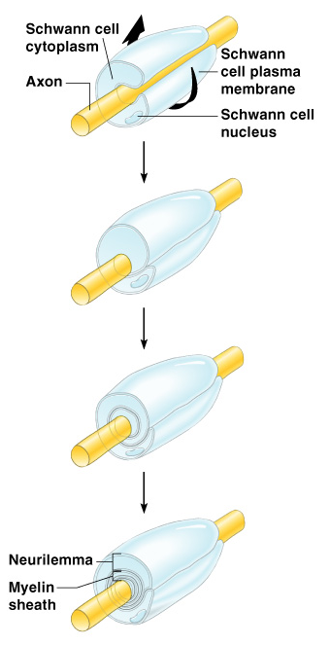
Nerve Fiber Coverings
Schwann cells – produce myelin sheaths in jelly-roll like fashion
Nodes of Ranvier – gaps in myelin sheath along the axon
Figure 7.5

Slide 19
Neuron Cell Body Location
Most are found in the central nervous system
  Gray matter – cell bodies and unmylenated fibers
  Nuclei – clusters of cell bodies within the white matter of the central nervous system
Ganglia – collections of cell bodies outside the central nervous system

Slide 20
Functional Classification of Neurons
Sensory (afferent) neurons
  Carry impulses from the sensory receptors
    Cutaneous sense organs
    Proprioceptors – detect stretch or tension
Motor (efferent) neurons
  Carry impulses from the central nervous system

Slide 21
Functional Classification of Neurons
Interneurons (association neurons)
  Found in neural pathways in the central nervous system
  Connect sensory and motor neurons

Slide 22
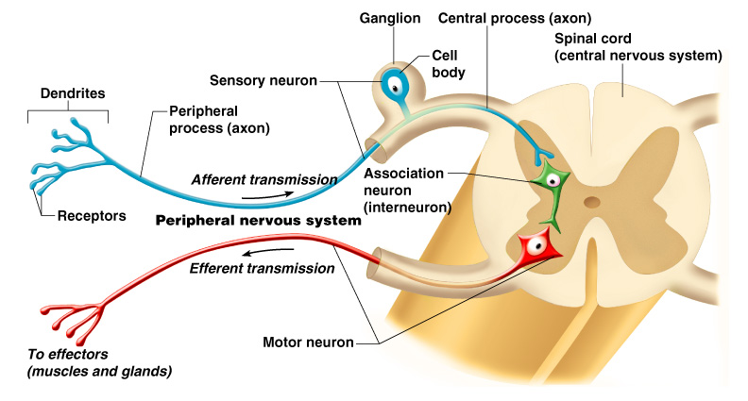
Neuron Classification
Figure 7.6

Slide 23
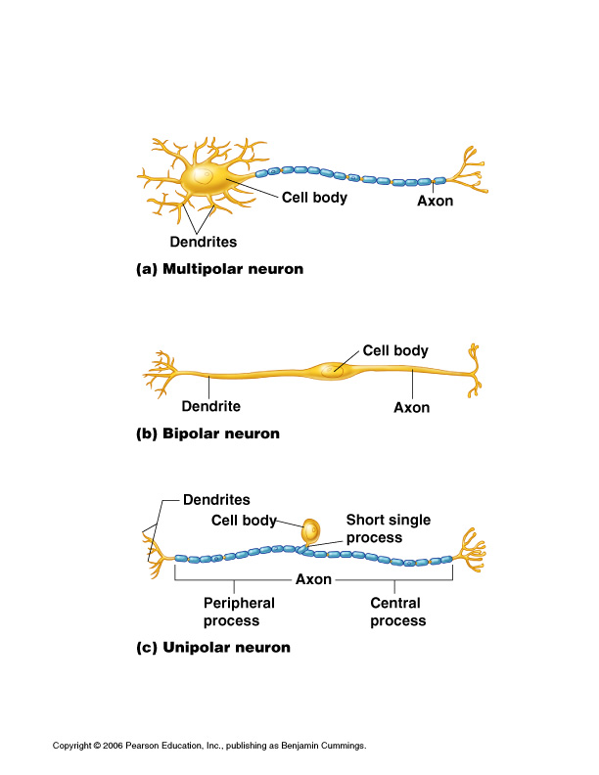
Structural Classification of Neurons
Multipolar neurons – many extensions from the cell body
Figure 7.8a

Slide 24
Structural Classification of Neurons
Bipolar neurons – one axon and one dendrite
Figure 7.8b

Slide 25
Structural Classification of Neurons
Unipolar neurons – have a short single process leaving the cell body
Figure 7.8c

Slide 26
Functional Properties of Neurons
Irritability – ability to respond to stimuli
Conductivity – ability to transmit an impulse
The plasma membrane at rest is polarized
  Fewer positive ions are inside the cell than outside the cell

Slide 27
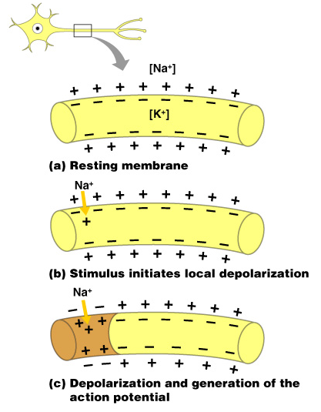
Starting a Nerve Impulse
Depolarization – a stimulus depolarizes the neuron’s membrane
A deploarized membrane allows sodium (Na⁺) to flow inside the membrane
The exchange of ions initiates an action potential in the neuron
Figure 7.9a–c

Slide 28
The Action Potential
If the action potential (nerve impulse) starts, it is propagated over the entire axon
Potassium ions rush out of the neuron after sodium ions rush in, which repolarizes the membrane
The sodium-potassium pump restores the original configuration
  This action requires ATP

Slide 29
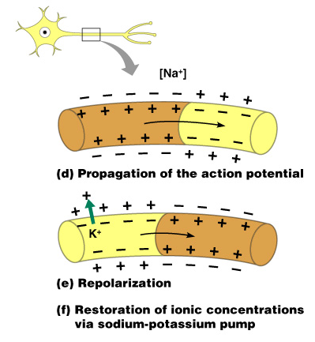
Nerve Impulse Propagation
The impulse continues to move toward the cell body
Impulses travel faster when fibers have a myelin sheath
Figure 7.9d–f

Slide 30
Continuation of the Nerve Impulse between Neurons
Impulses are able to cross the synapse to another nerve
  Neurotransmitter is released from a nerve’s axon terminal
  The dendrite of the next neuron has receptors that are stimulated by the neurotransmitter
  An action potential is started in the dendrite

Slide 31
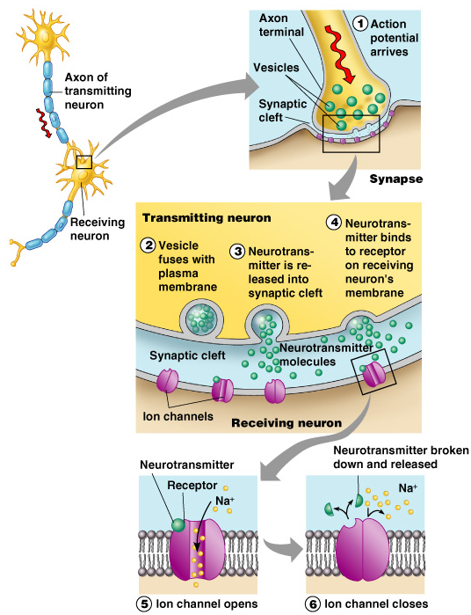
How Neurons Communicate at Synapses
Figure 7.10

