Slide 1
The Cardiovascular System (Heart)

Slide 2
The Cardiovascular System
A closed system of the heart and blood vessels
  The heart pumps blood
  Blood vessels allow blood to circulate to all parts of the body
The function of the cardiovascular system is to deliver oxygen and nutrients and to remove carbon dioxide and other waste products

Slide 3
The Heart
The heart is approximately the size of your fist, it’s hollow and cone shaped. Surprisingly, it’s weight is less than a pound.
Located in the mediastinum, the middle cavity of the thorax and flanked by two lungs.
The apex points towards the left hip and rests on the diaphragm. (The muscle that moves to change the volume of your lungs)

Slide 4
The larger portion or the base points towards the right shoulder and lies beneath the second rib.
The heart is enclosed in a double sac membrane called the pericardium.
A slippery fluid called serous fluid allows the heart to beat in a near frictionless environment.

Slide 5
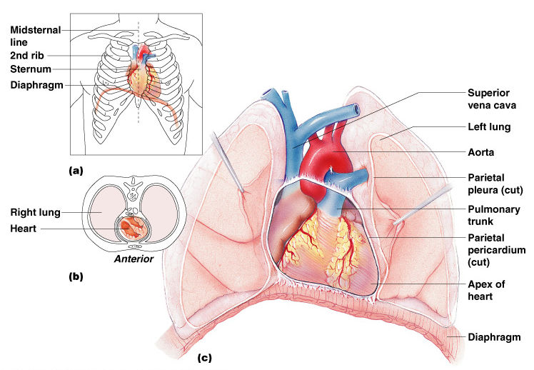
The Heart
Figure 11.1

Slide 6
The Heart: Heart Wall
Three layers
  Epicardium
    Outside layer
    Connective tissue layer
  Myocardium
    Middle layer
    Mostly cardiac muscle
  Endocardium
    Inner layer

Slide 7
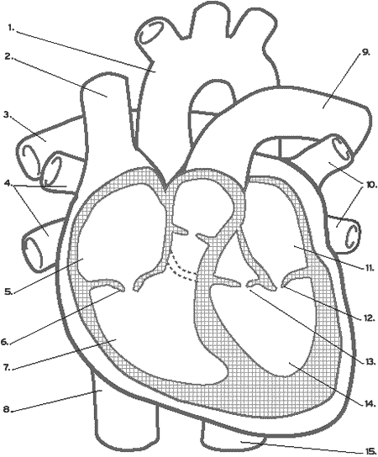
External Heart Anatomy
Figure 11.2a

Slide 8
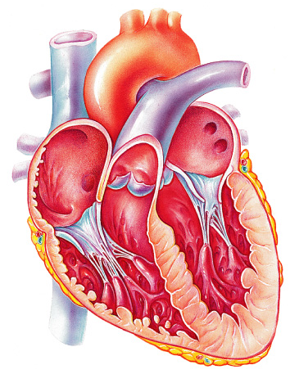
The Heart: Chambers
Right and left side act as separate pumps
Four chambers
  Atria
    Receiving chambers are supplied
    with blood from the veins.
      Right atrium
      Left atrium
  Ventricles
    Discharging chambers pump blood
    out to the body through arteries.
      Right ventricle
      Left ventricle
Figure 11.2c

Slide 9
Flow Within The Heart: Valves
Allow blood to flow in only one direction
Four valves
  Atrioventricular valves (AV) – between atria and ventricles
    Bicuspid valve (left)
    Tricuspid valve (right)
  Semilunar valves between ventricle and artery
    Pulmonary valve
    Aortic valve

Slide 10
The Heart: Valves
Valves open as blood is pumped through
Held in place by chordae tendineae (“heart strings”)
Close to prevent backflow

Slide 11
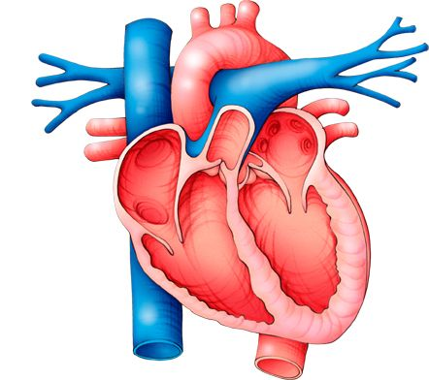

Slide 12
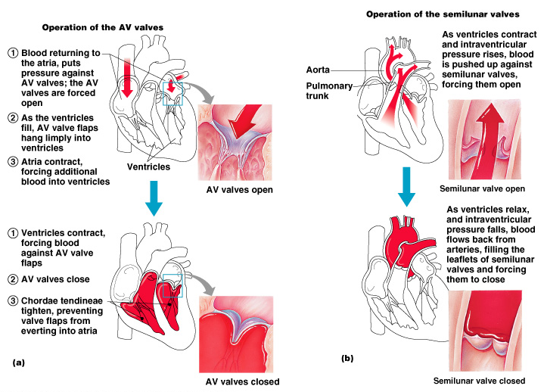
Operation of Heart Valves
Figure 11.4

Slide 13
Pulmonary Circulation
Pulmonary Circulation-The flow of blood between the heart and the lungs.
Deoxygenated blood leaves the right ventricle and goes to the lungs via the pulmonary artery. The blood picks up oxygen in the lungs and returns to left atrium of the heart via the pulmonary vein.

Slide 14
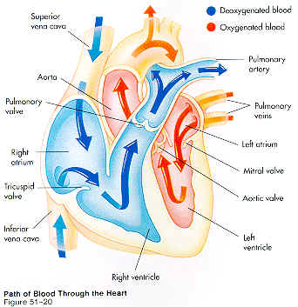

Slide 15
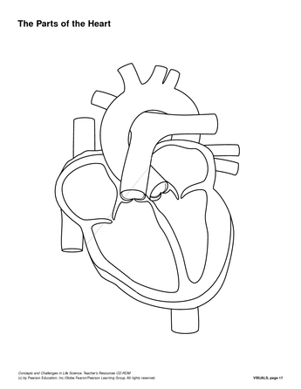

Slide 16
Systemic Circulation
Systemic Circulation-The oxygenated blood leaves the heart via the aorta and flows throughout the body. The deoxygenated blood returns to the right atrium of the heart via the inferior or superior vena cava.

Slide 17
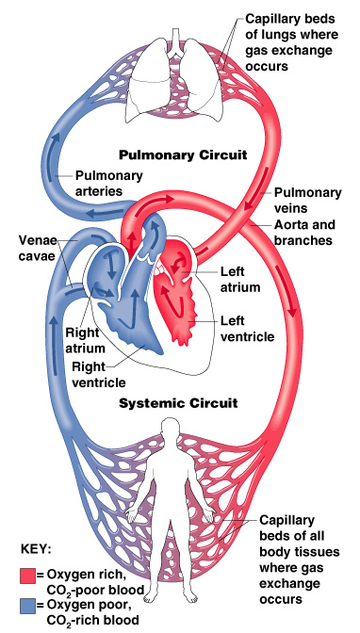
Blood Circulation
Figure 11.3

Slide 18
The Heart: Associated Great Vessels
Aorta
  Leaves left ventricle out to the body
Pulmonary arteries
  Leave right ventricle out to the lungs
Vena cava (Superior or Inferior)
  Enters right atrium from the body
Pulmonary veins (four)
  Enter left atrium from the lungs

Slide 19
General Rule-With Exceptions
Arteries carry oxygenated blood out of the heart to the body
  EXCEPTION-Pulmonary artery carries deoxygenated blood out of the heart to the lungs.
Veins carry deoxygenated blood back to the heart from the body.
  EXEPTION-Pulmonary vein carries oxygenated blood to the heart from the lungs.

Slide 20
Coronary Circulation
Blood in the heart chambers does not nourish the myocardium
The heart has its own nourishing circulatory system
  4 major coronary arteries (clogging causes heart attack)
  Cardiac veins

Slide 21
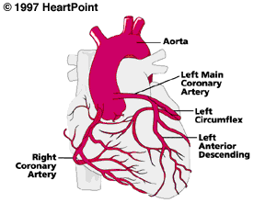
4 Major Coronary Arteries

Slide 22
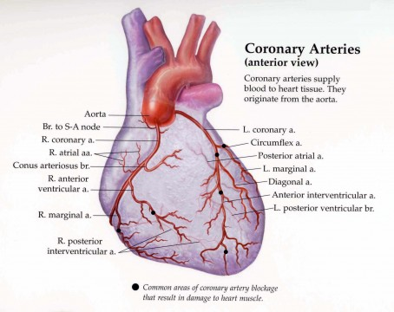

Slide 23
What is a Heart Attack?
A heart attack occurs when blood flow to a part of your heart is blocked for a long enough time that part of the heart muscle is damaged or dies. The medical term for this is myocardial infarction.

Slide 24
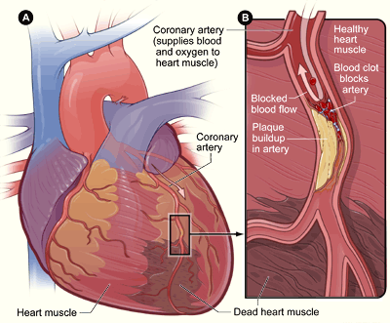
Blockage

Slide 25
Avoiding Surgery
Patients may experience the effects of a heart attack at any time of day. Some people are lucky enough to get treatment and not need surgery. A stent may be used to open up the clogged artery.

Slide 26
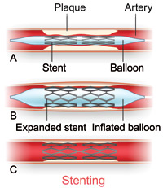
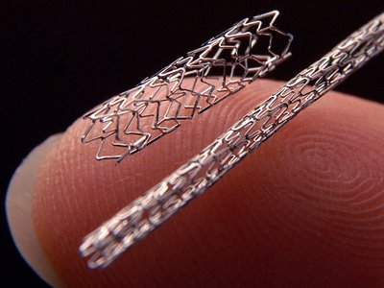
Inserting a Stent

Slide 27
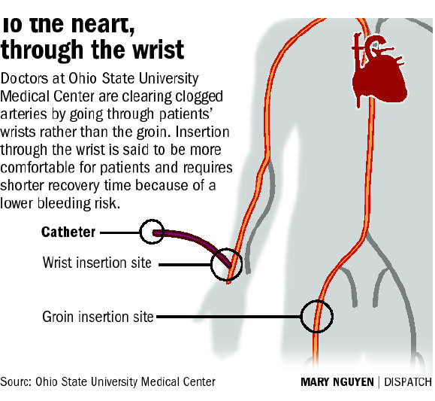

Slide 28
The Heart: Conduction System
Intrinsic conduction system
(nodal system)
  Heart muscle cells contract, without nerve impulses, in a regular, continuous way
  Can be restarted with electrical current

Slide 29


Slide 30
The Heart: Conduction System
Special tissue sets the pace
    Sinoatrial Node-Located in the right atrium and initiate the contraction
      Pacemaker
    Atrioventricular Node-Located between the atria and the ventricles
    Purkinje Fibers-Spread within the muscles of the ventricle walls.

Slide 31
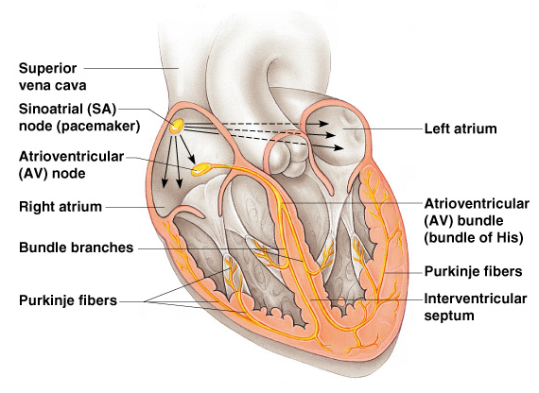
Heart Contractions
Figure 11.5

Slide 32
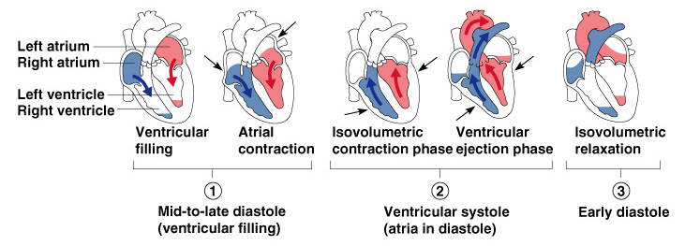
Filling of Heart Chambers – The Cardiac Cycle
Figure 11.6

Slide 33
The Cardiac Cycle
The events in one complete cycle of heartbeats.
The average heart beats about 75 beats per minute.
Atria contract simultaneously
Atria relax, then ventricles contract
Systole = contraction
Diastole = relaxation

Slide 34
The Heart: Cardiac Cycle
Cardiac cycle – events of one complete heart beat
  Mid-to-late diastole – blood flows into ventricles
  Ventricular systole – blood pressure builds before ventricle contracts, pushing out blood
  Early diastole – atria finish re-filling, ventricular pressure is low

Slide 35
The Heart: Cardiac Output
Cardiac output (CO)
  Amount of blood pumped by each side of the heart in one minute
  CO = (heart rate [HR]) x (stroke volume [SV])
Stroke volume
  Volume of blood pumped by each ventricle in one contraction

Slide 36
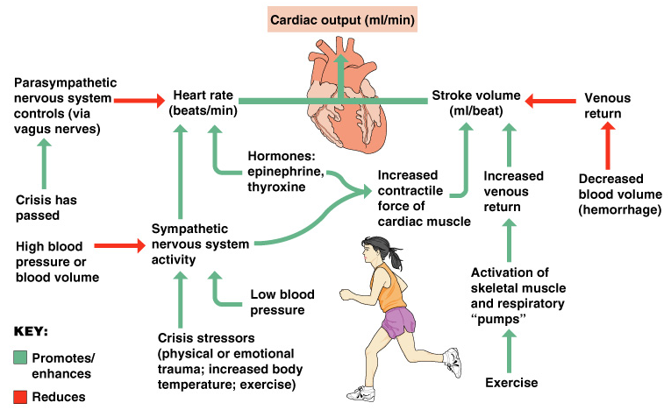
Cardiac Output Regulation
Figure 11.7

