Slide 1
The Digestive System and Body Metabolism

Slide 2
The Digestive System and Body Metabolism
Digestion
  Breakdown of ingested food
  Absorption of nutrients into the blood
Metabolism
  Production of cellular energy (ATP)
  Constructive and degradative cellular activities

Slide 3
Organs of the Digestive System
Two main groups
  Alimentary canal – continuous coiled hollow tube
  Accessory digestive organs

Slide 4
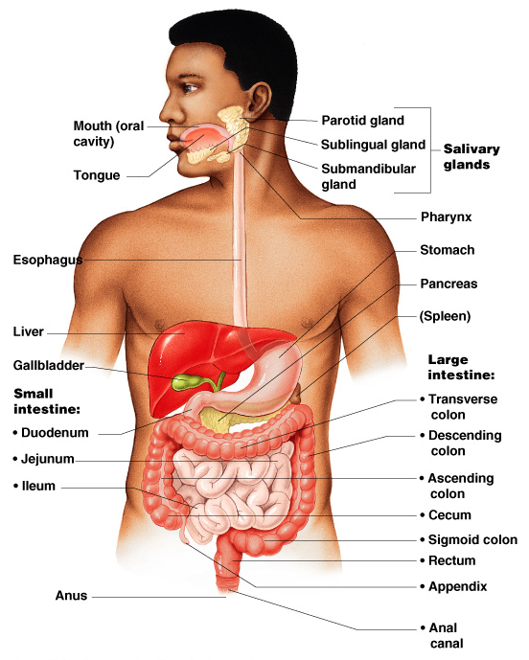
Figure 14.1

Slide 5
Organs of the Alimentary Canal
Mouth
Pharynx
Esophagus
Stomach
Small intestine
Large intestine
Anus

Slide 6
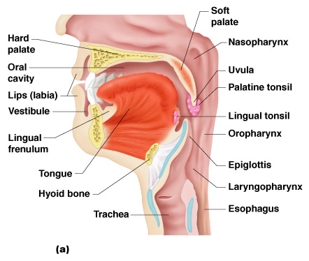
Mouth (Oral Cavity) Anatomy
Lips – protect
the anterior opening
Hard palate – forms
the anterior (front)
roof of the mouth
Soft palate – forms
the posterior
(back) roof
Uvula – fleshy
projection of the
soft palate
Figure 14.2a

Slide 7
Oral cavity – area contained by the teeth
Tongue – Muscular extension aiding in speech and balling of food.
Tonsils
  Palatine tonsils
  Lingual tonsils
Figure 14.2a

Slide 8
Processes of the Mouth
Mastication (chewing) of food
Mixing masticated food with saliva
Initiation of swallowing by the tongue
Allowing for the sense of taste

Slide 9
Pharynx Function
Serves as a passageway for air and food
Food is propelled to the esophagus by two muscle layers
  Longitudinal inner layer
  Circular outer layer
Food movement is by alternating contractions of the muscle layers (peristalsis)

Slide 10
Esophagus
Runs from pharynx to stomach through the diaphragm
Conducts food by peristalsis
(slow rhythmic squeezing)

Slide 11
Layers of Alimentary Canal Organs
Mucosa
  Innermost layer
  Moist membrane
    Small amount of connective tissue
    Small smooth muscle layer

Slide 12
Layers of Alimentary Canal Organs
Submucosa
  Just beneath the mucosa
  Soft connective tissue with blood vessels, nerve endings, and lymphatics

Slide 13
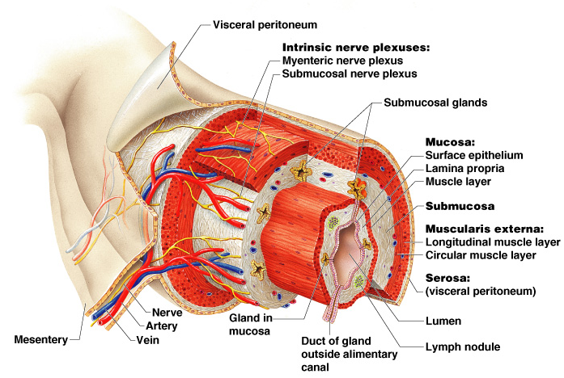
Layers of Alimentary Canal Organs
Figure 14.3

Slide 14
Stomach Anatomy
Located on the left side of the abdominal cavity
Food enters at the cardioesophageal sphincter
Food empties into the small intestine at the pyloric sphincter

Slide 15
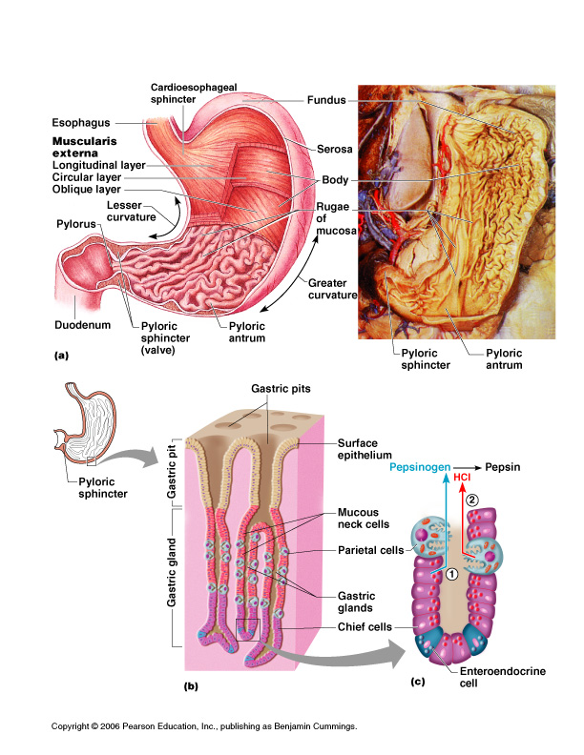
Stomach Anatomy
Figure 14.4a

Slide 16
Stomach Functions
Acts as a storage tank for food
Site of food breakdown
Chemical breakdown of protein begins
Delivers chyme (processed food) to the small intestine

Slide 17
Specialized Mucosa of the Stomach
Simple columnar epithelium
  Mucous neck cells – produce a sticky alkaline mucus
  Gastric glands – secrete gastric juice
  Chief cells – produce protein-digesting enzymes (pepsinogens)
  Parietal cells – produce hydrochloric acid
  Endocrine cells – produce gastrin

Slide 18
Structure of the Stomach Mucosa
Gastric pits formed by folded mucosa
Glands and specialized cells are in the gastric gland region

Slide 19
Structure of the Stomach Mucosa
Figure 14.4b–c

Slide 20
Small Intestine
The body’s major digestive organ
Site of nutrient absorption into the blood
Suspended from the posterior abdominal wall by the mesentery

Slide 21
Subdivisions of the Small Intestine
Duodenum
  Attached to the stomach
  Curves around the head of the pancreas
Jejunum
  Attaches anteriorly to the duodenum
Ileum
  Extends from jejunum to large intestine

Slide 22
Chemical Digestion in the Small Intestine
Source of enzymes that are mixed with chyme
  Intestinal cells
  Pancreas
Bile enters from the gall bladder

Slide 23
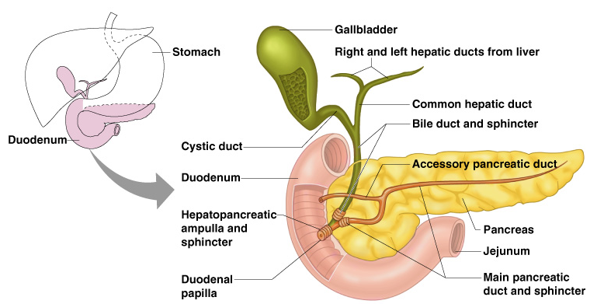
Figure 14.6

Slide 24
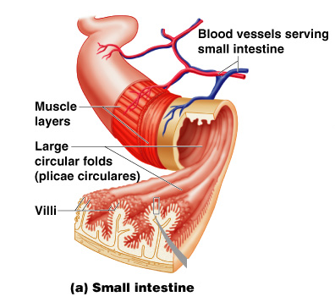
Villi of the Small Intestine
Fingerlike structures formed by the mucosa
Give the small intestine more surface area
Figure 14.7a

Slide 25
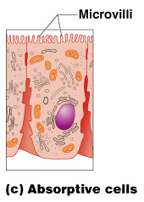
Microvilli of the Small Intestine
Small projections of the plasma membrane
Found on absorptive cells
Figure 14.7c

Slide 26
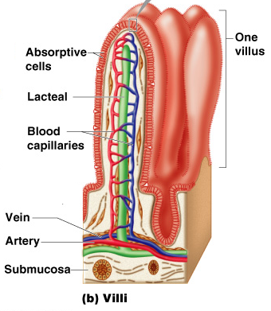
Structures Involved in Absorption of Nutrients
Absorptive cells
Blood capillaries
Figure 14.7b

Slide 27
Large Intestine
Larger in diameter, but shorter than the small intestine
Frames the internal abdomen

Slide 28
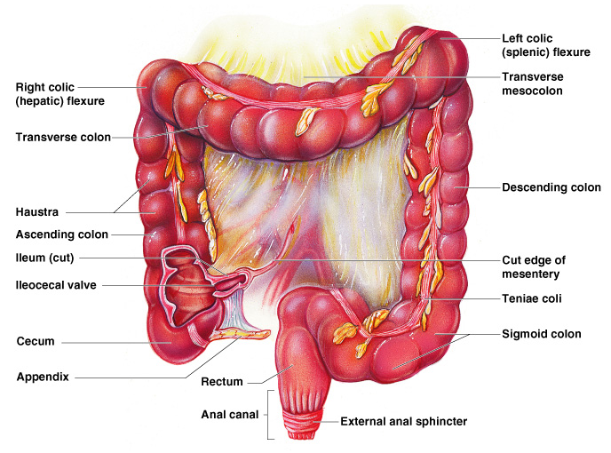
Figure 14.8

Slide 29
Functions of the Large Intestine
Absorption of water
Eliminates indigestible food from the body as feces
Does not participate in digestion of food
Goblet cells produce mucus to act as a lubricant

Slide 30
Structures of the Large Intestine
Cecum – saclike first part of the large intestine
Appendix
  Accumulation of lymphatic tissue that sometimes becomes inflamed (appendicitis)
  Hangs from the cecum

Slide 31
Structures of the Large Intestine
Colon
Rectum
Anus – external body opening

Slide 32
Accessory Digestive Organs
Salivary glands
Teeth
Pancreas
Liver
Gall bladder

Slide 33
Salivary Glands
Saliva-producing glands
  Parotid glands – located anterior to ears
  Submandibular glands
  Sublingual glands

Slide 34
Saliva
Mixture of mucus and serous fluids
Helps to form a food bolus
Contains salivary amylase to begin starch digestion
Dissolves chemicals so they can be tasted

Slide 35
Teeth
The role is to masticate (chew) food
Humans have two sets of teeth
  Deciduous (baby or milk) teeth
  20 teeth are fully formed by age two

Slide 36
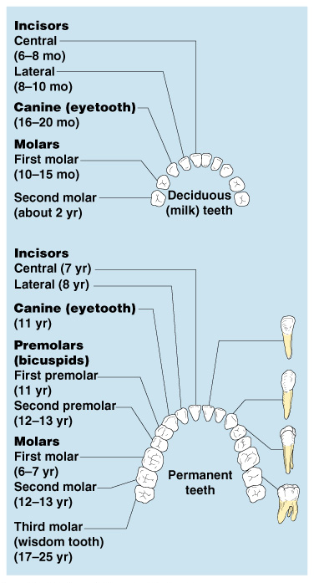
Classification of Teeth
Figure 14.9

Slide 37
Pancreas
Produces digestive enzymes that break down all categories of food into the duodenum
Alkaline fluid introduced with enzymes neutralizes acidic chyme
Endocrine product of the pancreas
  Insulin

Slide 38
Liver
Largest gland in the body and produces bile
Located on the right side of the body under the diaphragm
Connected to the gall bladder via the common hepatic duct

Slide 39
Gall Bladder
Stores bile from the liver by way of the cystic duct
Bile is introduced into the duodenum in the presence of fatty food
Gallstones can cause blockages

Slide 40
Processes of the Digestive System
Ingestion – getting food into the mouth
Propulsion – moving foods from one region of the digestive system to another

Slide 41
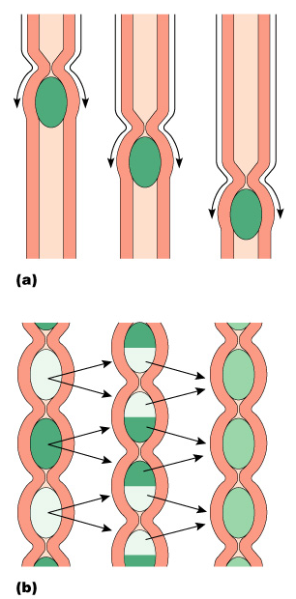
Processes of the Digestive System
Peristalsis – alternating waves of contraction
Segmentation – moving materials back and forth to aid in mixing
Figure 14.12

Slide 42
Processes of the Digestive System
Mechanical digestion
  Mixing of food in the mouth by the tongue
  Churning of food in the stomach

Slide 43
Processes of the Digestive System
Chemical Digestion
  Enzymes break down food molecules into their building blocks
  Each major food group uses different enzymes

Slide 44
Processes of the Digestive System
Absorption
  End products of digestion are absorbed in the blood or lymph
Defecation
  Elimination of indigestible substances as feces

Slide 45
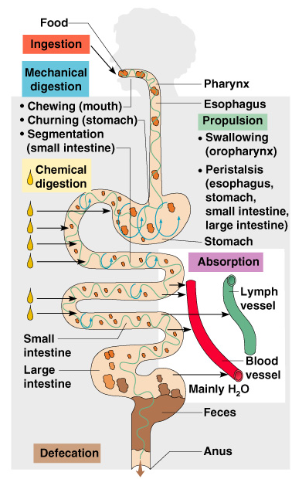
Processes of the Digestive System
Figure 14.11

Slide 46
Digestive Activities of the Mouth
Mechanical breakdown
  Food is physically broken down by chewing
Chemical digestion
  Food is mixed with saliva
  Breaking of starch into maltose by salivary amylase

Slide 47
Activities of the Pharynx and Esophagus
These organs have no digestive function
Serve as passageways to the stomach

Slide 48
Deglutition (Swallowing)
Buccal phase
  Voluntary
  Occurs in the mouth
  Food is formed into a bolus and forced into the pharynx by the tongue

Slide 49
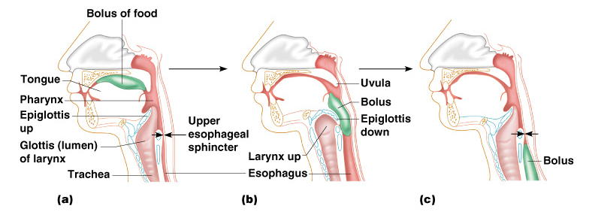
Figure 14.14

Slide 50
Food Breakdown in the Stomach
Gastric juice is regulated by neural and hormonal factors
Hydrocholoric acid makes the stomach contents very acidic

Slide 51
Necessity of an Extremely
Acid Environment in the Stomach
Activates pepsinogen to pepsin for protein digestion
Provides a hostile environment for microorganisms

Slide 52
Digestion and Absorption in the Stomach
Protein digestion enzymes
  Pepsin – an active protein digesting enzyme
  Rennin – works on digesting milk protein
The only absorption that occurs in the stomach is of alcohol and aspirin

Slide 53
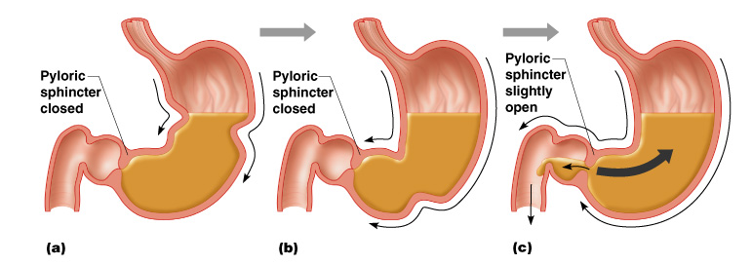
Propulsion in the Stomach
Food must first be well mixed
Rippling peristalsis occurs in the lower stomach
Figure 14.15

Slide 54
The pylorus meters out chyme into the small intestine (30 ml at a time)
The stomach empties in four to six hours
Figure 14.15

Slide 55
Digestion in the Small Intestine
Pancreatic enzymes play the major digestive function
  Responsible for fat digestion (lipase)
  Digest nucleic acids (nucleases)
  Alkaline content neutralizes acidic chyme

Slide 56
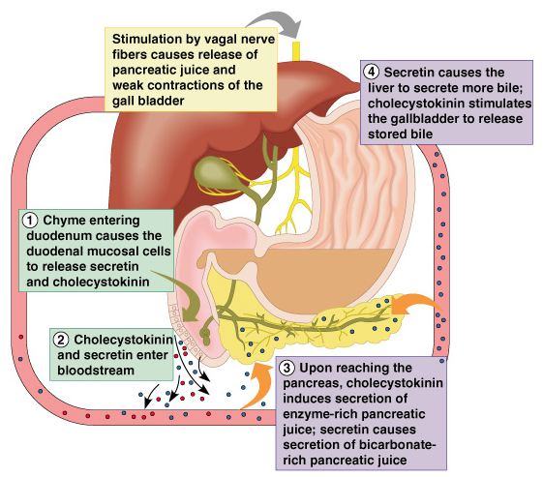
Stimulation of the Release of Pancreatic Juice
Vagus nerve
Local hormones
  Secretin
  Cholecystokinin
Figure 14.16

Slide 57
Absorption in the Small Intestine
Water is absorbed along the length of the small intestine
End products of digestion

Slide 58
Propulsion in the Small Intestine
Peristalsis is the major means of moving food
Segmental movements
  Mix chyme with digestive juices
  Aid in propelling food

Slide 59
Food Breakdown and Absorption in the Large Intestine
No digestive enzymes are produced
Resident bacteria digest remaining nutrients
  Produce some vitamin K and B
  Release gases
Water and vitamins K and B are absorbed
Remaining materials are eliminated via feces

Slide 60
Propulsion in the Large Intestine
Sluggish peristalsis
Mass movements
  Slow, powerful movements
  Occur three to four times per day
Presence of feces in the rectum causes a defecation reflex
  Internal anal sphincter is relaxed
  Defecation occurs with relaxation of the voluntary (external) anal sphincter

Slide 61
Developmental Aspects of the Digestive System
The alimentary canal is a continuous tube by the fifth week of development
Digestive glands bud from the mucosa of the alimentary tube
The developing fetus receives all nutrients through the placenta
In newborns, feeding must be frequent, peristalsis is inefficient, and vomiting is common

Slide 62
Developmental Aspects of the Digestive System
Teething begins around age six months
Metabolism decreases with old age
Middle age digestive problems
  Ulcers
  Gall bladder problems

Slide 63
Developmental Aspects of the Digestive System
Activity of digestive tract in old age
  Fewer digestive juices
  Peristalsis slows
  Diverticulosis and cancer are more common

