Slide 1
The Cardiovascular
System

Slide 2
The Heart: Regulation of Heart Rate
Stroke volume usually remains relatively constant
  Starling’s law of the heart – the more that the cardiac muscle is stretched, the stronger the contraction
Changing heart rate is the most common way to change cardiac output

Slide 3
The Heart: Regulation of Heart Rate
Ways to increase your heart rate
  Sympathetic nervous system
    Crisis
    Low blood pressure
  Hormones
    Epinephrine-increase heart rate, constrict blood vessels and dilates air passages
    Thyroxine-Thyroid hormone that increases metabolic rate and heart rate
  Exercise
  Decreased blood volume

Slide 4
The Heart: Regulation of Heart Rate
Decreased heart rate
  Rest and deep breathing
  High blood pressure or blood volume
  Prescribed medications such as
  Lopressor intravenous

Slide 5
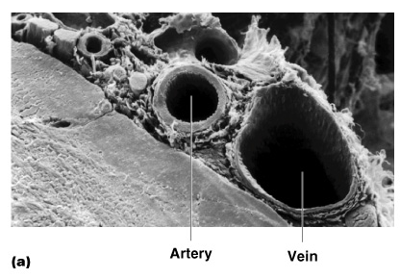
Blood Vessels: The Vascular System
Taking blood to the tissues and back
  Arteries
  Capillaries
  Veins
Figure 11.8a

Slide 6
Blood Vessels: Anatomy
Three layers (tunics)
  Tunic intima
    Endothelium
  Tunic media
    Smooth muscle
    Controlled by sympathetic nervous system
  Tunic externa
    Mostly fibrous connective tissue

Slide 7
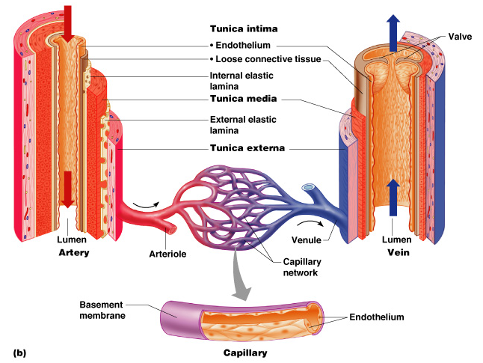
The Vascular System
Figure 11.8b

Slide 8
Differences Between Blood Vessel Types
Walls of arteries are the thickest with smooth muscle to help move blood
Skeletal muscle “milks” blood in veins toward the heart. Backflow is prevented with valves
Walls of capillaries are only one cell layer thick to allow for exchanges between blood and tissue

Slide 9
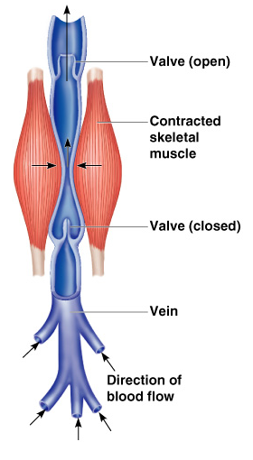
Movement of Blood Through Vessels
Most arterial blood is pumped by the heart
Veins use the milking action of muscles to help move blood. Valves in the veins prevent backflow.
Figure 11.9

Slide 10
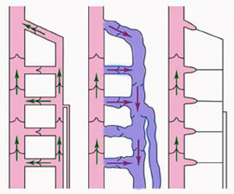
What if the valves fail?
Normal blood flow is green. If the valves fail, blood flows backward and causes varicose veins to form.

Slide 11
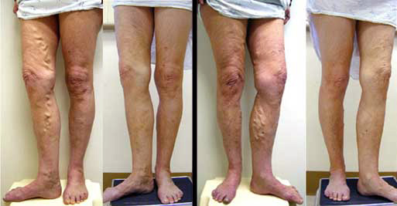

Slide 12
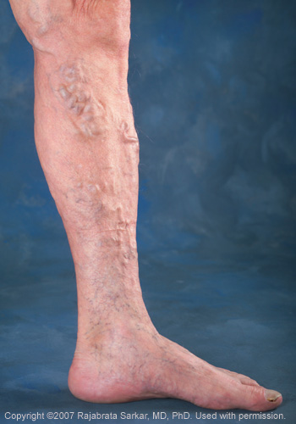
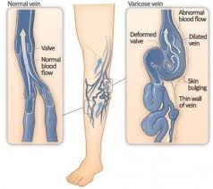

Slide 13
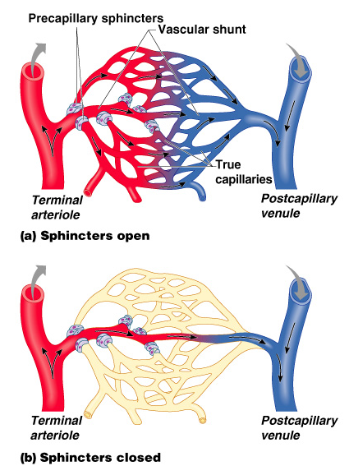
Capillary Beds
Capillary beds allow for an easy exchange between the blood and the body tissues.
Figure 11.10

Slide 14
Capillary Beds
True capillaries – exchange vessels
    Oxygen and nutrients cross to cells
    Carbon dioxide and metabolic waste products cross into blood
Figure 11.10

Slide 15
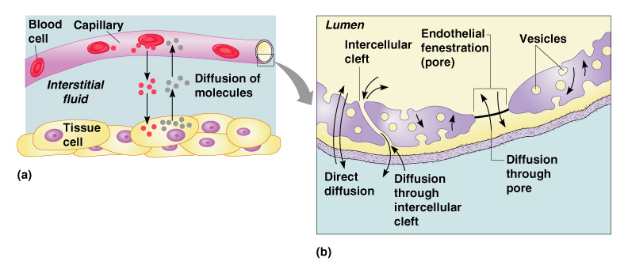
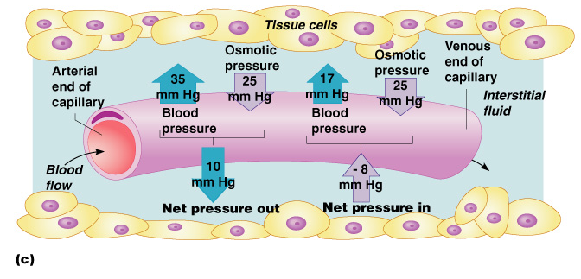
Diffusion at Capillary Beds
Figure 11.20

Slide 16
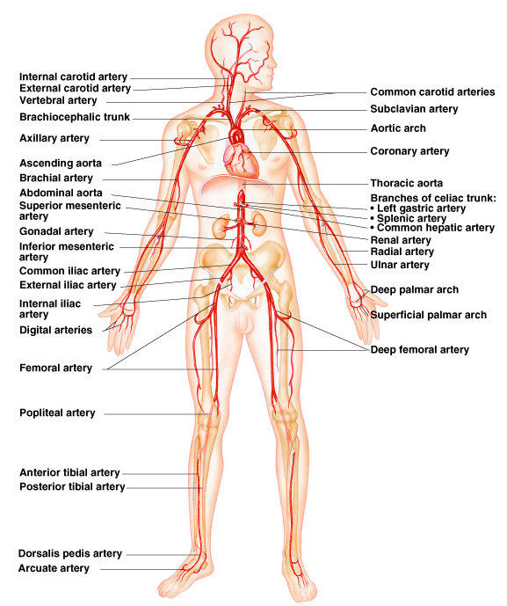
Major Arteries of Systemic
Circulation
Figure 11.11

Slide 17
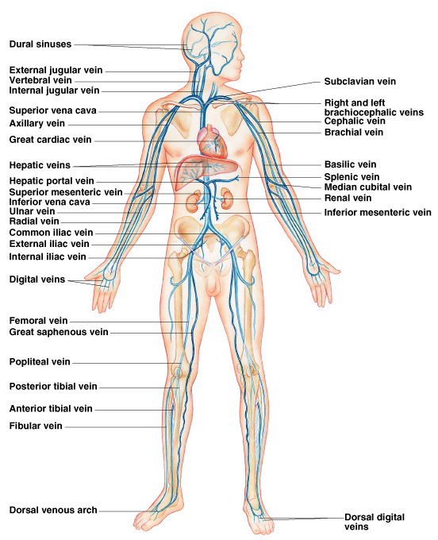
Major Veins of Systemic Circulation
Figure 11.12

Slide 18
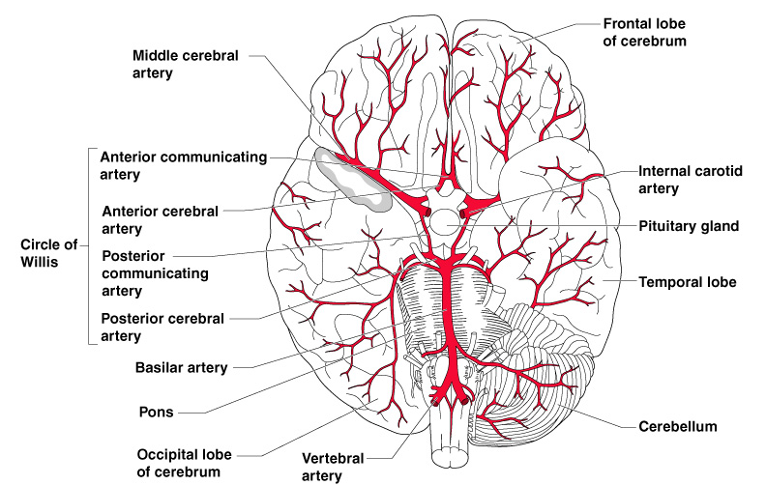
Arterial Supply of the Brain
Figure 11.13

Slide 19
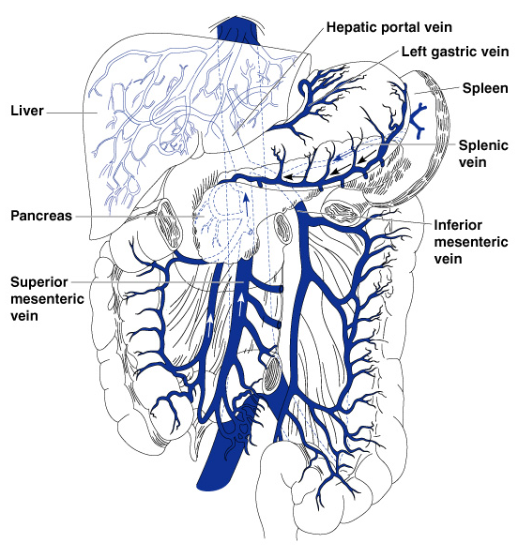
Hepatic Portal Circulation
Figure 11.14

Slide 20
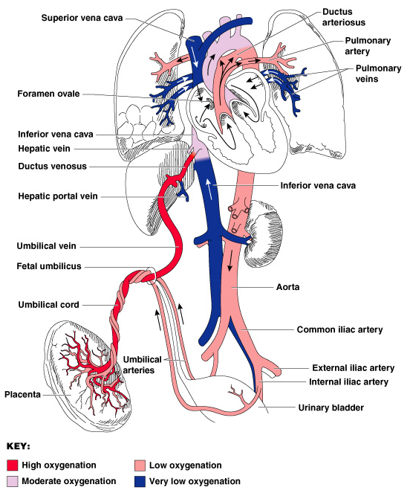
Circulation to the Fetus
Figure 11.15

Slide 21
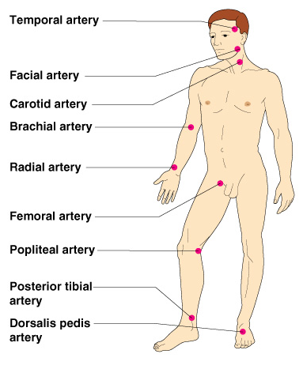
Pulse
Pulse – pressure wave of blood
Monitored at “pressure points” where pulse is easily palpated
The average pulse rate is 70-76 beats per minute.
Figure 11.16

Slide 22
Blood Pressure
Measurements by health professionals are made on the pressure in large arteries
  Systolic – pressure at the peak of ventricular contraction
  Diastolic – pressure when ventricles relax
Pressure in blood vessels decreases as the distance away from the heart increases

Slide 23
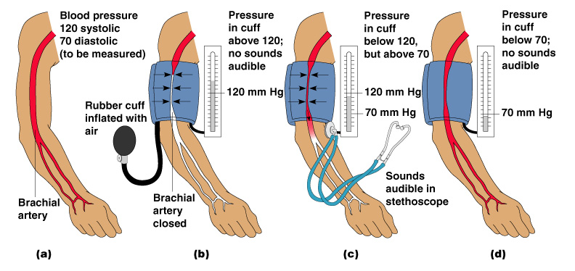
Measuring Arterial Blood Pressure
Figure 11.18

Slide 24
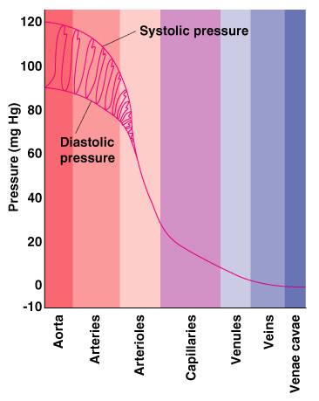
Comparison of Blood Pressures in Different Vessels
Figure 11.17

Slide 25
Blood Pressure: Effects of Factors
Neural factors
  Autonomic nervous system adjustments (sympathetic division)
Renal factors
  Regulation by altering blood volume
  Renin – hormonal control

Slide 26
Blood Pressure: Effects of Factors
Temperature
  Heat has a vasodilation effect
  Cold has a vasoconstricting effect
Chemicals (prescription drugs)
  Various substances can cause increases or decreases
Diet

Slide 27
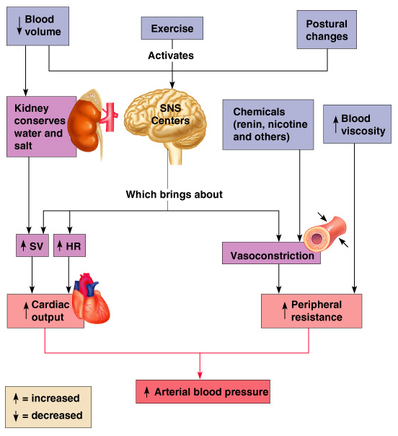
Factors Determining Blood Pressure
Figure 11.19

Slide 28
Variations in Blood Pressure
Human normal range is variable
  Normal
    140–110 mm Hg systolic
    80–75 mm Hg diastolic
  Hypotension
    Low systolic (below 110 mm HG)
    Often associated with illness
  Hypertension
    High systolic (above 140 mm HG)
    Can be dangerous if it is chronic

Slide 29
Developmental Aspects of the Cardiovascular System
A simple “tube heart” develops in the embryo and pumps by the fourth week
The heart becomes a four-chambered organ by the end of seven weeks
Few structural changes occur after the seventh week

Slide 30
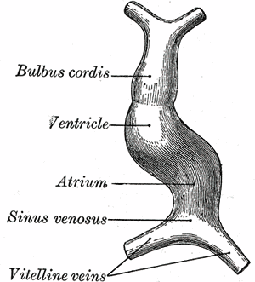
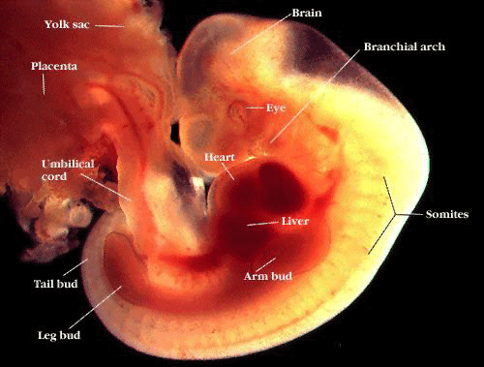
Simple Tube vs. 4 Chambered Heart

